Slide 1
RMG & RMG-Cat Workshop
ACS CATL Fall 2022
Open-Source Software Workshops
August 25th 2022
Yunsie Chung, Bjarne Kreitz

Slide 2


Slide 3
Workshop agenda
RMG overview
How to run RMG
RMG demo
RMG hands-on session
RMG-Cat overview
RMG-Cat demo & hands-on session
Concluding remarks + Q&A

Slide 4
1. RMG Overview

Slide 5
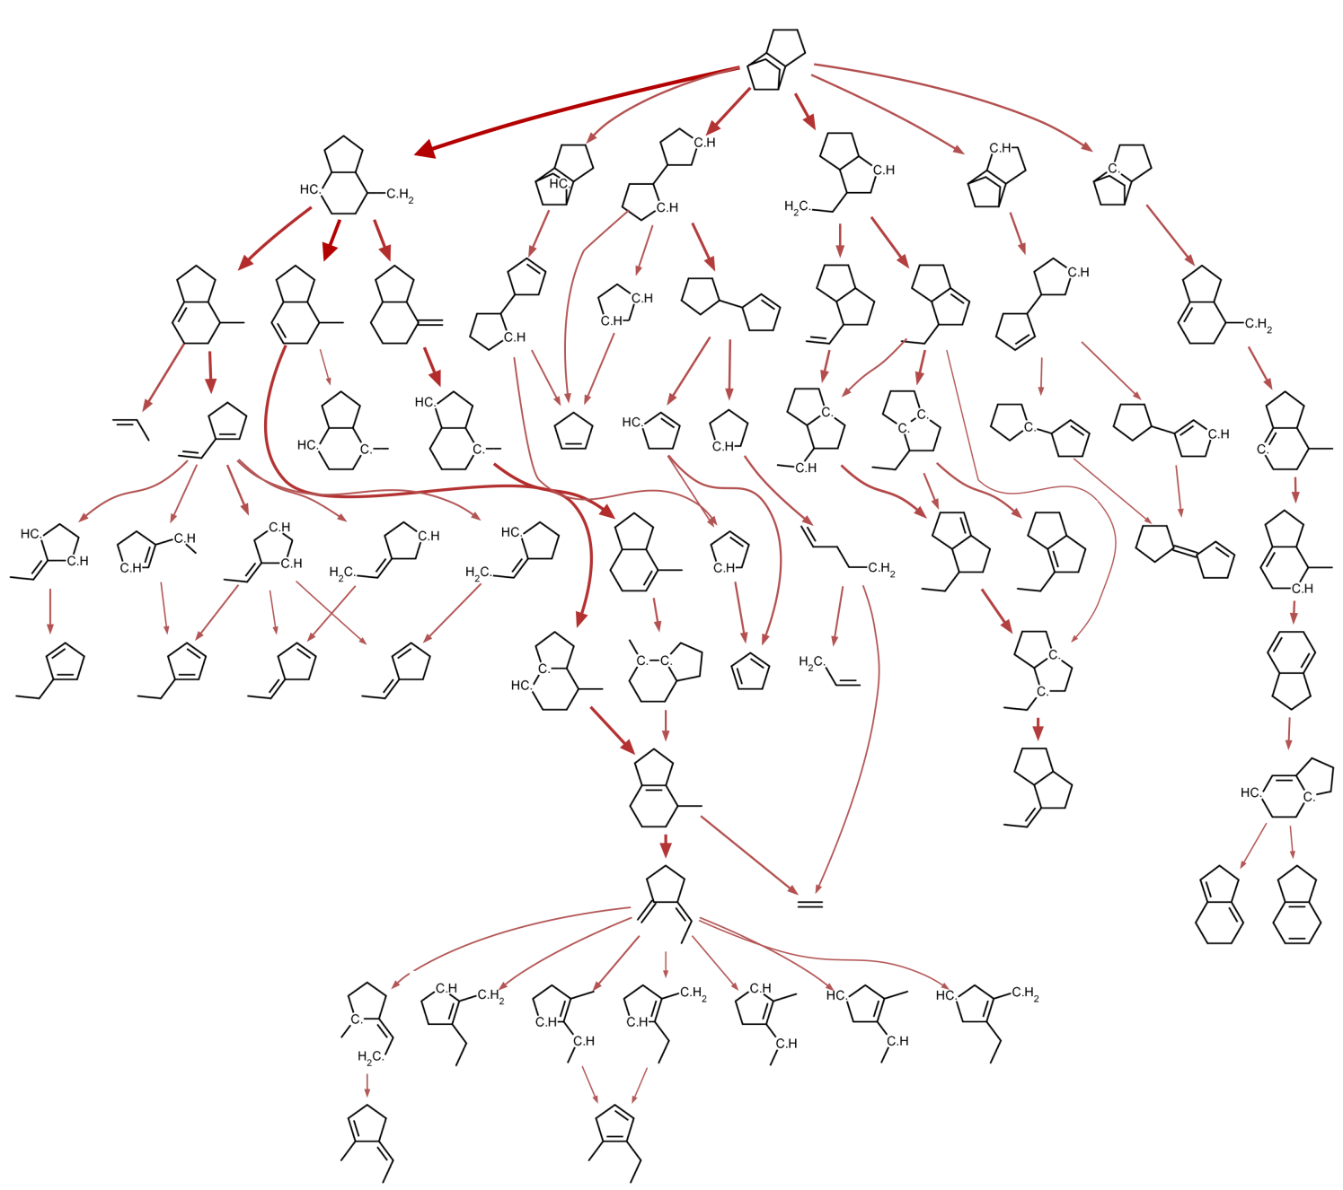
Reaction Mechanism Generator
A predictive tool for reacting chemical systems
constructs comprehensive models consisting of elementary reactions
estimates unknown kinetics and thermochemistry data
Large open source package under active development, includes many tools for building/solving/analyzing kinetic models for broad range of systems
Databases & methods for estimating all the parameters in the models
M. Liu, et al., J. Chem. Inf. Model. 61 (2021) 2686-2696

Slide 6
Purpose of RMG
RMG aims to predict the reactive chemistry of a given system by automatically determining the relevant species and reactions under the specified conditions. It will solve for:
All & significant intermediate species
All & significant reactions
All rate coefficients and thermodynamic properties of species
+ Reduce the human effort needed to construct a useful kinetic model, so make it more practical to build good models.
+ Current version of RMG is particularly useful for pyrolysis & combustion, but it can be applied to other systems (e.g. surface catalysis, liquid phase).

Slide 7
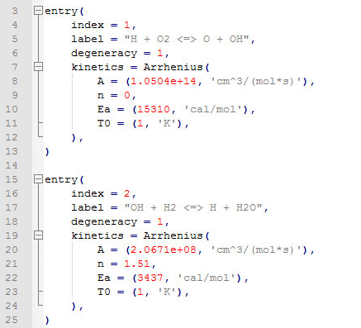




How RMG Works
Inlet conditions and composition (T, P, X)
Kinetic and thermodynamic libraries
Kinetic model
Tolerance
Termination criteria
(time, conversion)
RMS
Notes:
Library: python text files that contain the Arrhenius parameters. Tolerance: one of the input settings. The tolerance parameters determine which reactions and species are significant ones. RMG finds the characteristic rate at any point in time. Every species with net flux above the certain percentage above the characteristic rate is moved to the core species. Smaller tolerance -> bigger model, bigger tolerance -> smaller model
Termination: reaction time, conversion, ..

Slide 8
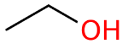
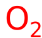

Reaction Mechanism Generator
Example: ethanol oxidation
1000 ppm fuel, stoichiometric O₂, in Ar
at 1500 K, 1 bar
Core
Edge
Notes:
Let’s visualize RMG simulation with a simple ethanol oxidation example.
RMG defines Core and Edge species. Core species are the species whose flux is above the certain tolerance that the user sets.
First, we start with initial reactants, and RMG will place all the initial species inside the Core. Air is set to inert.

Slide 9
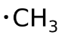
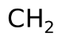
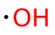
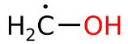
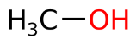
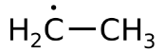
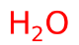
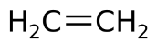
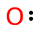
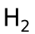
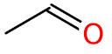
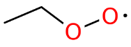
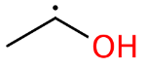
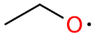
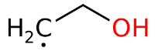
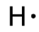
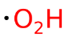
Reaction Mechanism Generator
Example: ethanol oxidation
1000 ppm fuel, stoichiometric O₂, in Ar
at 1500 K, 1 bar
+
unknown kinetics / thermodynamics
data are estimated
Notes:
Then it generates all possible reactions using the core species, whether unimolecular and bimolecular. This rates are estimated either using the kinetic parameters in the RMG libraries or using heuristics, which I will talk about later. The new compounds are placed into the Edge.

Slide 10
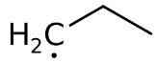
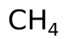
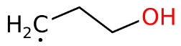
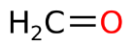
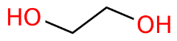
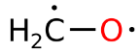
Reaction Mechanism Generator
Example: ethanol oxidation
1000 ppm fuel, stoichiometric O₂, in Ar
at 1500 K, 1 bar
+
Notes:
Next, RMG tries to find which one of these Edge species has flux above the tolerance to be moved to the Core species.

Slide 11

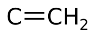
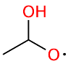
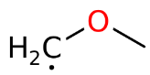
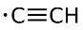
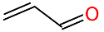
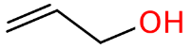
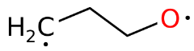
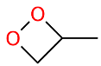
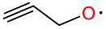
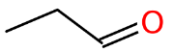
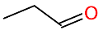
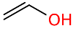
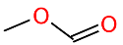
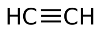
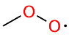
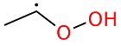
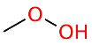
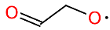
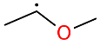
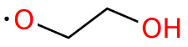
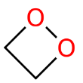
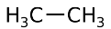
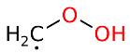


























Reaction Mechanism Generator
Example: ethanol oxidation
1000 ppm fuel, stoichiometric O₂, in Ar
at 1500 K, 1 bar
Notes:
RMG will repeat this process iteratively until the convergence criteria is reached.

Slide 12
Reaction Mechanism Generator
Example: ethanol oxidation
1000 ppm fuel, stoichiometric O₂, in Ar
at 1500 K, 1 bar
Core:
42 species, 592 reactions
Core + Edge: 775 species, 1604 reactions
(tolerance = 1%; termination rate ratio = 0.1%; execution time = 30 min)
Notes:
It takes 30 minutes to run on a normal laptop. RMG explored lots of reactions and species. This was a brief overview of how RMG algorithm works.

Slide 13
Ab initio rate calculations or experimental data
Detailed kinetic mechanism; predictions
Notes:
If we think of RMG as a black box, you feed in the experimental data or ab initio calculations as input to the black box and run the simulation at the condition you want. And RMG will output the detailed kinetic mechanisms and simulations.

Slide 14



Ab initio rate calculations or experimental data
k(T,P)
Uncertainty analysis
Solvent effects on Thermo
Catalysis systems and surface reactions
Core
kinetic & thermo database
Rate rules
Edge
Detailed kinetic mechanism; predictions
Group additivity
Notes:
If you open the black box to see what’s inside, we first have the database for kinetics and thermo. If the reactions and species generated during the RMG simulation are not available in the database, RMG will estimate their values. For thermos of speices, RMG primarily uses group additivity. We have another thermos estimation method using machine learning, but the machine learning is the preliminary ones so the group additivity is the main method for the thermos estimation.
For kinetics, RMG uses a reaction family using tree-based structure, which I will discuss later. RMG then uses these estimated and database values to simulate and determine the core and edge species. RMG also has several other features. For example, RMG can run pressure-dependent system as well, which can estimate the pressure-dependent rate coefficient on the fly. It also has uncertainty analysis and can estimate solvent effects on thermos and simulate catalysis systems with surface chemistry.
And once you have the models, you can check which reactions the model is sensitive to, and then refine the models by re-computing the rates of the sensitive reactions and species with higher level ab initio calcualtions.

Slide 15

Thermo estimator in RMG
Benson group additivity
With corrections:
Gauche interactions
1,5-Interactions
Cyclic and polycyclic
Radical
ΔH_{f,298K} = 2H_{f,298K}^{>C=O} + 3H_{f,298K}^{-CH3} + 3H_{f,298K}^{-N<}
+ 2H_{f,298K}^{=C<} + H_{f,298K}^{=N-} + H_{f,298K}^{=CH-}
rmg.mit.edu website
has widgets for doing
many types of estimates
C_{p} (T) = …. S∘_{298K} = …
Notes:
How RMG estimates the thermos. Heat capacity, enthalpy, entropy.

Slide 16

Kinetic estimation using template based reaction scheme
O
O
RMG has an extensible set of reaction families (~100 including surface reaction families)
Notes:
For kinetic estimation, RMG categorizes reactions into many different reaction families.

Slide 17
Rate Coefficient k∞(T) estimations – rate rules
+
R=R
C=R
C≡R
O=R
N=R
N≡R
S=R
C=O
C=C
C=N
C=S
CH₂=C
C–CH=C
C(C)C=C
S–C=C
O–C=C
•O–C=C
R•
H•
C•
O•
N•
S•
•R•
Notes:
Let’s look at R_Addition_MultipleBond reaction family to see how the rate is estimated within the reaction family.
RMG defines a tree structure with nodes representing the reactant in the reaction template.
For example, it has a tree for R=R reactant first. And as you descend down the tree, the structure of the reactant becomes more defied. E.g. which atoms, bond types, … For example, under C=R, it defines other R, and you can go further down the tree until you reach the very specific node for the reactant.
Then it has a second tree for the second reactant.
If we want to estimate the rate for this particular reaction, it will combine the two nodes in the tree. For more details on how the rate is estimated using the tree, you could watch the “Parameter Estimation” video from our last year’s virtual workshop.

Slide 18
2. How to run RMG

Slide 19
Installation Guide
http://reactionmechanismgenerator.github.io/RMG-Py/users/rmg/installation/anacondaUser.html
Disclaimer: RMG can be operated under only one of these conditions:
Linux OS (virtual machine or native)
Linux subsystem in windows
* Windows OS is not directly supported and only binary version is supported in Mac OS.
For non-Linux users: Setting up Linux virtual machine or Linux Subsystem on Windows
Installation options:
Option 1: For basic users, binary installation using Anaconda
Option 2: For developers, installation by source using Anaconda Environment
Notes:
So with these basics in mind, we

Slide 20
General procedure for running RMG using binary
Binary installation using Anaconda
conda create -c defaults -c rmg -c rdkit -c cantera -c pytorch -c conda-forge --name rmg_env rmg rmgdatabase
Activate the Conda environment for RMG
conda activate rmg_env If it doesn’t work, try: source activate rmg_env
To run the input file
rmg.py /path/to/your/input.py Output files will be placed in the same directory as your input file by default

Slide 21
RMG input file format
Reactor Specification
simpleReactor(temperature=(1000,'K'), pressure=(1.0,'bar'), initialMoleFractions={ 'H2':.67, 'O2':.33}, terminationConversion={ 'H2': 0.9}, terminationTime=(1e6,'s’))
Database Specification
database(thermoLibraries = ['primaryThermoLibrary'], reactionLibraries = [], seedMechanisms = [], kineticsDepositories = ['training'], kineticsFamilies = ‘default’ kineticsEstimator = 'rate rules')
Model and simulator parameters
simulator(atol=1e-16, rtol=1e-8) model(toleranceKeepInEdge=0.0, toleranceMoveToCore=0.001, toleranceInterruptSimulation=0.001, maximumEdgeSpecies=100000) options(units='si', generateOutputHTML=True, generatePlots=False, saveEdgeSpecies=True, saveSimulationProfiles=True)
Species Specification
species(label='H2', reactive=True, structure=SMILES("[H][H]"))
species(label='O2', reactive=True, structure=SMILES("[O][O]"))

Slide 22

Database specification
thermoLibraries – list of libraries of thermodynamic parameters in order of how trusted they are. ‘primaryThermoLibrary’ is a commonly used one.
reactionLibraries – list of libraries of reactions and associated rate parameters to add to the model edge in order of trust
seedMechanisms – list of libraries of reactions and associated rate parameters to add to the model core in order of trust
kineticsDepositories: [‘training’]
kineticsFamilies: ‘default’
kineticsEstimator : ‘rate rules’

Slide 23

Species specification
All defined species are placed in the model core at initialization
If reactive is False, no reactions will be generated for that species (default is True)
Can define species using InChI, SMILES, or adjlist

Slide 24

Reactor specification: Simple Reactor
At least 1 reactor must be specified
SimpleReactor is for a homogeneous, isothermal, isobaric batch reactor for gaseous systems.
Temperature, pressure, and initialMoleFractions are required
At least 1 termination criteria must be specified
This defines end point of the reactor simulation, not the RMG simulation

Slide 25

Reactor specification: Liquid Reactor
LiquidReactor is for a homogenous, isothermal, constant volume batch reactor with liquid-phase systems.
Only one bulk solvent can be specified and the rest of the species are considered dilute solutes.
Temperature, initial concentrations, and a solvent must be specified.
constantSpecies can be a list of species which should have constant concentrations during the simulation.
List of available solvents (all Abraham, Mintz, and viscosity parameters must be available): http://rmg.mit.edu/database/solvation/libraries/solvent/
Solvent search tool: https://rmg.mit.edu/database/solvation/solventSearch/

Slide 26
Termination criteria for a reactor
terminationTime – Can always simulate to a specific time, but we usually don’t know how long a reaction will take, not good to simulate too far after most chemistry ends (not computer time! It’s reaction time)
terminationConversion – Often have some idea what the value is, but intermediate models may not reach that conversion and may terminate early before all the chemistry finishes
terminationRateRatio – Terminates when characteristic rate reaches a given fraction of the maximum characteristic rate observed so far
Notes:
terminnationRateRatio is much more robust than the other two

Slide 27


Model and simulator parameters
Default settings from the example input file are good place to start
Refer to the documentation and previous workshop videos for more details

Slide 28
RMG input file examples and documentation
RMG input file examples and library files can be found on RMG Git Repositories
RMG input file examples:
RMG-Py/examples/rmg: https://github.com/ReactionMechanismGenerator/RMG-Py/tree/main/examples/rmg
RMG-Py/examples/rmg/commented/input.py: contains detailed explanation on each input argument
RMG-Py/examples/rmg/superminimal/input.py: simplest input file to run
Documentation: http://reactionmechanismgenerator.github.io/RMG-Py/users/rmg/input.html
RMG library examples:
Thermo libraries (RMG-database/input/thermo/libraries) : https://github.com/ReactionMechanismGenerator/RMG-database/tree/main/input/thermo/libraries
Kinetic libraries (RMG-database/input/kinetics/libraries): https://github.com/ReactionMechanismGenerator/RMG-database/tree/main/input/kinetics/libraries
For more details, refer to “Running RMG Jobs” video from our previous workshops.

Slide 29
3. RMG demo Minimal example (ethane pyrolysis)

Slide 30


Slide 31
3. RMG demo liquid_phase_constSPC example (octane autoxidation with a constant oxygen concentration)

Slide 32


Slide 33
4. RMG hands-on session

Slide 34
Try RMG exercises
Link: https://github.com/yunsiechung/RMG_workshop
Download the materials by clicking the green button at the top (“Code”) and clicking “Downdload ZIP”.
Open “RMG_exercises” folder.
Read “README_RMG_exercises.pdf” file to choose the RMG exercise to try (among Exercises 1, 2, and 3)

Slide 35
5. RMG-Cat overview

Slide 36


Heterogeneous catalysis in RMG
RMG can generate mechanisms for heterogeneously catalyzed systems
However, currently only for …
Gas-phase molecules containing C, H, O
Single terrace sites (eg. Pt(111))
Coupled homogeneous/heterogeneous systems
Examples of RMG-Cat
Catalytic partial oxidation of CH₄
Steam reforming of CH₄
CO₂ methanation
Oxidation of hydrocarbons
How does RMG-Cat work?
CO₂ methanation on Ni(111)
Goldsmith and West, J. Phys. Chem. C (2017)
Kreitz et al., ChemRxiv (2022)
Kreitz et al., JACS Au. (2021)

Slide 37

How does RMG-Cat work?
Exactly as RMG for gas- or liquid-phase reactions
Representation of adsorbates?
Reaction templates?
Estimation of surface kinetics and thermophysical parameters of adsorbates?
Reactors?
Mazeau et al., ACS Catal. (2021)

Slide 38



Representation of adsorbates
RMG represents surface species the same as gas-phase species
Adsorption site is denoted as X

Slide 39
Representation of adsorbates
CHX
1 C u0 p0 c0 {2,S} {3,T}
2 H u0 p0 c0 {1,S}
3 X u0 p0 c0 {1,T}
X is a surface site
Represented by Pt in SMILES
Physisorbed species (van der Waals)
In recipe: bond order 0
Site must be still be specified
Multidentate adsorbates
Multiple bonds with the surface
Notation is straightforward
CH
Pt
H2 Vdw
1 X u0 p0 c0
2 H u0 p0 c0 {3,S}
3 H u0 p0 c0 {2,S}
H₂
Pt
C2H3X2
1 C u0 p0 c0 {2,S} {3,S} {4,S} {6,S}
2 C u0 p0 c0 {1,S} {5,S} {7,D}
3 H u0 p0 c0 {1,S}
4 H u0 p0 c0 {1,S}
5 H u0 p0 c0 {2,S}
6 X u0 p0 c0 {1,S}
7 X u0 p0 c0 {2,D}
H
H
H
C
C
Pt
Pt

Slide 40

Thermochemistry of Adsorbates
Blondal et al., (2019)
Tree-structured DFT database
Pt(111)
108 species
BEEF-vdW
Includes all species with no
more than 2 heavy atoms
Some heavier adsorbates
have been added
Kreitz et al., ChemRxiv (2022)

Slide 41

Estimate binding energies on other metals
Linear scaling relations
Descriptor species
d-band principle
One database to rule them all!
Estimate the thermo of all metals from Pt(111)
Only applicable for other (111) facets!
Works also for complex adsorbates
CH₃-X
CH₂=X
CH≡X
Abild-Pedersen et al., Phys. Rev. Lett. (2007)

Slide 42
Linear scaling relations
Only the binding energy of the descriptors is required which are
C*, N*, O*, S*, (H*)
Abild-Pedersen et al., Phys. Rev. Lett. (2007)

Slide 43

Change in binding energy scales with bond order

Slide 44
Change in binding energy scales with bond order

Slide 45


If it is not in the database?
gas-phase species from
database or group additivity estimate
Rules of thumb
ΔfH(298) = ΔfHgas + ΔHadsorption + ΔEbinding
ΔS(298) = ΔSgas + ΔSadsorption
Cp(T) = Cpgas + ΔCpadsorption
Changed by linear scaling relations for different metals
estimated from adsorption correction thermo trees
(derived from DFT and statistical mechanics)

Slide 46
Why Platinum?
catalystProperties(
bindingEnergies = {
'H': (-2.754, 'eV/molecule’),
'O': (-3.811, 'eV/molecule’),
'C': (-7.025, 'eV/molecule’),
'N': (-4.632, 'eV/molecule'),
},
surfaceSiteDensity=(2.483e-9, 'mol/cm^2'),
)
It‘s the usual reference for many groups
How to choose different metals
Provide binding energies for H, C, O, N
Bimetallics and alloys
You can now choose the metal directly in RMG
We provided binding energies for some (111) surfaces
Pt, Ni, Ru, Ag, Cu, Co, Fe, Rh, Au
catalystProperties(
metal = ‘Ni111’
)

Slide 47
Surface reaction families – how it started
R1
R2
R1
R1
dissociative adsorption
X3
+
X4
⇌
X3
+
X4
R1
R1
non-dissociative adsorption
+
X2
⇌
X2
R2
R1
R1
R2
Dissociation
X3
+
X4
⇌
X3
+
X4
R2
R2
R1
R3
R1
R3
Abstraction
X4
+
X5
⇌
X4
+
X5

Slide 48









Surface reaction families – how it’s going
Eley-Rideal
Vdw adsorption abstraction
Recombination Single
Vdw dissociation
Surface Migration
Vdw double dissociation
Vdw abstraction
Vdw dual adsorption
Vdw addition
… and we are still adding more

Slide 49



As with thermo, RMG first looks for rate coefficients in a database:
“can I find this reaction in my kinetics database?”
If not, then estimate it.
RMG-Cat uses bond-specific BEP relations,
but other options are available
E_{a} = E_{o} + 𝛼△H
Hermet, J. "Theoretical study of protonic conduction in Gd-doped BaCeO3 : an electrolyte for fuel cell." PhD diss., Ecole Centrale Paris, 2013.

Slide 50


Surface reaction rates
$$k=A{\left(\frac{T}{T_{0}}\right)}^{n}exp\left(\frac{−Ea}{RT}\right)$$
Surface concentrations in mol/m²
Reaction orders can be A+*, A+B*, A*, A*+B*, A+*+*, A+B*+*, A*+*, A*+*+*, etc.
SurfaceArrhenius is like Arrhenius, but with more units
Surface rate coefficients have to accept more units - but we still check it’s right.
StickingCoefficient is like Arrhenius, but always in range 0 – 1.0 (represents fraction of collisions with the surface that are successful)
Reactor simulation converts this into mass action kinetics based on surface site density, etc.
$$k=S\sqrt{\frac{k_{B}T}{2πM}}$$

Slide 51
Reactors
surfaceReactor(
temperature=(800,'K'),
initialPressure=(1.0, 'bar'),
initialGasMoleFractions={
"CH4": 0.0500,
"O2": 0.1995,
"N2": 0.7505,
},
initialSurfaceCoverages={
"X": 1.0,
},
surfaceVolumeRatio=(1.0e4, 'm^-1'),
terminationConversion = { "CH4":0.9 },
terminationRateRatio=0.01
)
based on LiquidReactor, because we want constant volume
Ranged Reactors
Initialize with gas mole fractions, surface coverages,
surface site density, surface-to-volume ratio,
and initial P (actual P may vary)
Solves in terms of number of moles (N) not mole fractions (y)
Rates are all converted into per-volume basis

Slide 52
6. RMG-Cat demo & hands-on session

Slide 53
Exercise 4: CO₂ hydrogenation on Ni(111)
Input species: CO₂, H₂
Ni(111)
'H':(-2.76, 'eV/molecule'),
'C':(-6.45, 'eV/molecule'),
‘O':(-4.70, 'eV/molecule’)
Surface site density 3.16e-9 mol/cm²
Include the following reaction libraries
Surface/Deutschmann_Ni
Conditions
T=673K, p=1 bar
Initial composition H₂ = 4 mol, CO₂=1 mol
Termination criterion: 90% CO₂ conversion
Checkout the generated files
output.html (output_edge.html)
Simulation results (folder solver)
What are the main products?
Tasks
Increase or decrease temperature (easy)
Change the metal to Ru0001 (advanced)
catalystProperties(
metal = ‘Ru0001’
)

Slide 54
Exercise 5: Oxidation of exhaust gas emissions
Input species: CO, H₂, CH₄, H₂O, CO₂, N₂
Pt(111)
Include the following reaction libraries
Surface/CPOX_Pt/Deutschmann2006
Conditions
T=600-973K, p=1 bar
nSims=3
Initial mole fractions
O₂=0.6%
CO₂=H₂O=12%
CH₄=0.3%, CO=0.5%, H₂=0.167%
N₂=74.43%
Termination rate ratio: 1e-10
Checkout the generated files
output.html (output_edge.html)
Simulation results
What are the main products?
Tasks
Play around with temperatures (easy)
Add 0.05% of C₂H₆ (very hard)
You need to add this molecule to the adjacencyList
C2H6
1 C u0 p0 c0
2 C u0 p0 c0
3 H u0 p0 c0
4 H u0 p0 c0
5 H u0 p0 c0
6 H u0 p0 c0
7 H u0 p0 c0
8 H u0 p0 c0
H
H
H
C
C
H
H
H

Slide 55
7. Concluding remarks

Slide 56
RMG: A summary
Open-source software that automatically constructs reaction mechanisms and microkinetic models
Gas phase chemistry
Liquid phase systems
Heterogeneous catalysis
Main features of RMG
Cheminformatics framework
Estimation of rates, thermochemistry
Flux-based algorithm
It is under active development

Slide 57
What have I learned today?
Overview of RMG’s features
Basic algorithms
Input and output file formats
Representation of molecules and adsorbates
Database structure/Estimation routines
Generation of mechanisms
Simple combustion and pyrolysis models
Liquid autoxidation model
Heterogenous catalysis models

Slide 58
Further information on RMG
RMG documentation: https://rmg.mit.edu/
Check out the RMG papers
RMG-Py (Gao et al, 2016, DOI: 10.1016/j.cpc.2016.02.013)
RMG-Py v.3.0 (Liu et al. 2020, DOI: 10.1021/acs.jcim.0c01480)
RMG-database (Johnson et al, 2022, DOI: 10.26434/chemrxiv-2022-0lp0g)
RMG-Cat papers (Goldsmith et al., 2017, DOI: 10.1021/acs.jpcc.7b02133)
Linear scaling (Mazeau et al. 2021. DOI: 10.1021/acscatal.0c04100)
General application (Kreitz et al. 2021. DOI: 10.1021/jacsau.1c00276)
Contact the developer team for any questions: rmg_dev@mit.edu

Slide 59
RMG resources
RMG website: rmg.mit.edu
Resources with previous workshop and slides: https://rmg.mit.edu/resources
ACS Fall 2022 Workshop materials and slides: https://github.com/yunsiechung/RMG_workshop
RMG Git repo (report issues or view updates)
RMG-Py: https://github.com/ReactionMechanismGenerator/RMG-Py
RMG-database: https://github.com/ReactionMechanismGenerator/RMG-database

Slide 60
 | Writing a model with 100+ species and 1000+ elementary reactions by hand
 | Using an automated Reaction Mechanism Generator
Questions?

